Slide 1
HOSA
Meeting
10/11/2023

Slide 2
Join the Remind!
HOSA Lower Chapter:
@hosalow24
HOSA Upper Chapter:
@hosaupp24

Slide 3
Follow us on Instagram!
@phuhs_hosa

Slide 4
Upper Chapter Board
Sama Shokr | President
Olivia Nguyen | President-Elect
Ena Ibrahimovic | Vice President
Esther Brietling | Corresponding Secretary
Rae Daniels | Recording Secretary
Jacey Ghaly | Recorder/Parliamentarian
Ryla Alabat | Treasurer
Briana Pate | Historian

Slide 5
Lower Chapter Board
Jai Popuri | President
Amna Ibrahimovic | President-elect
Samantha Bates | Vice President
Ema Alcani | Secretary
Skyler Rideout | Parliamentarian
Mathew Habib | Treasurer
Ravi Puvvula | Historian
Congratulations to our new Board members!!

Slide 6
Committee Leaders
Trevor Stinson | Conferences/Competitions
Christopher Hastings | HOSA Week
Rachael Uvieghara | Glam Run
Marolina Binyamen, Valerie Sanchez | Celebrations
Yassin Elsammek | Fundraising
Paola Prada | Philanthropy
Join A Committee
Fill out your contact information at the end of the meeting
Earn 2 membership points

Slide 7
Membership Points
Upper Chapter 11th & 12th :
15 points
Lower Chapter 9th &10th :
10 points
1 point for every meeting
Competing at States = enough membership points
We offer plenty of medical hours for various events
Seniors make sure you have 15 points by the end of the year for cords

Slide 8
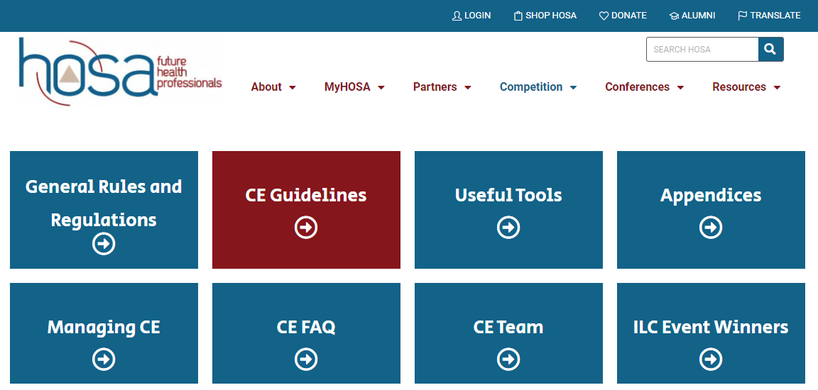
Competition Guidelines
You will find all the competitions on the HOSA website under the competitions tab

Slide 9
Regional Competitions
Date: January 20th
Location: Middleton High School
Transportation: Bus (we will all go together)
Sign Ups:
Tuesday, October 17: 12th & 10th grade competitors
Wednesday, October 18: 11th & 9th grade competitors
Location: Ms. Bartle’s room (6-101)
All competitors must take the Health Care Issues Exam
Date: 12/3-12/8

Slide 10
For partner/team events: 9th & 10th graders can compete together only, and 11th & 12th graders can compete together only
Have a printed copy of your guidelines when signing up. For partner and group events all group members must sign their name on the printed copy.
https://youtu.be/HuEWeS3uq8o?si=tmNuoOeIKY9UJESX

Slide 11
Guest Speaker!!
Ms. Larissa Garofola
Area Health Education Center (AHEC)
Scholars Regional Manager, Marketing & Training Specialist; Gulfcoast North AHEC, Inc.

Slide 12
Kimberly Home Ornament Making and Donations
Ornament Making
Date: 11/8/2023
Hours and Points: 2
Location: Dr. Daniel’s room (6-104)
Donations
Gift collection date: 11/13-12/13
Points and hours: TBA
Celebration: 12/13
More info soon

Slide 13
Become a Competition Mentor!
You can only become a mentor if you competed before
As a mentor, you will help Palm Harbor Middle School HOSA members prepare for their competitions

Slide 14
Become a Competition Mentor!
You can attend the PHMS meeting on Thursday morning, or help students in the classrooms after school
Volunteer paperwork will be at the PHMS front office
The number of hours you mentor, will be the number of hours earned.

Slide 15
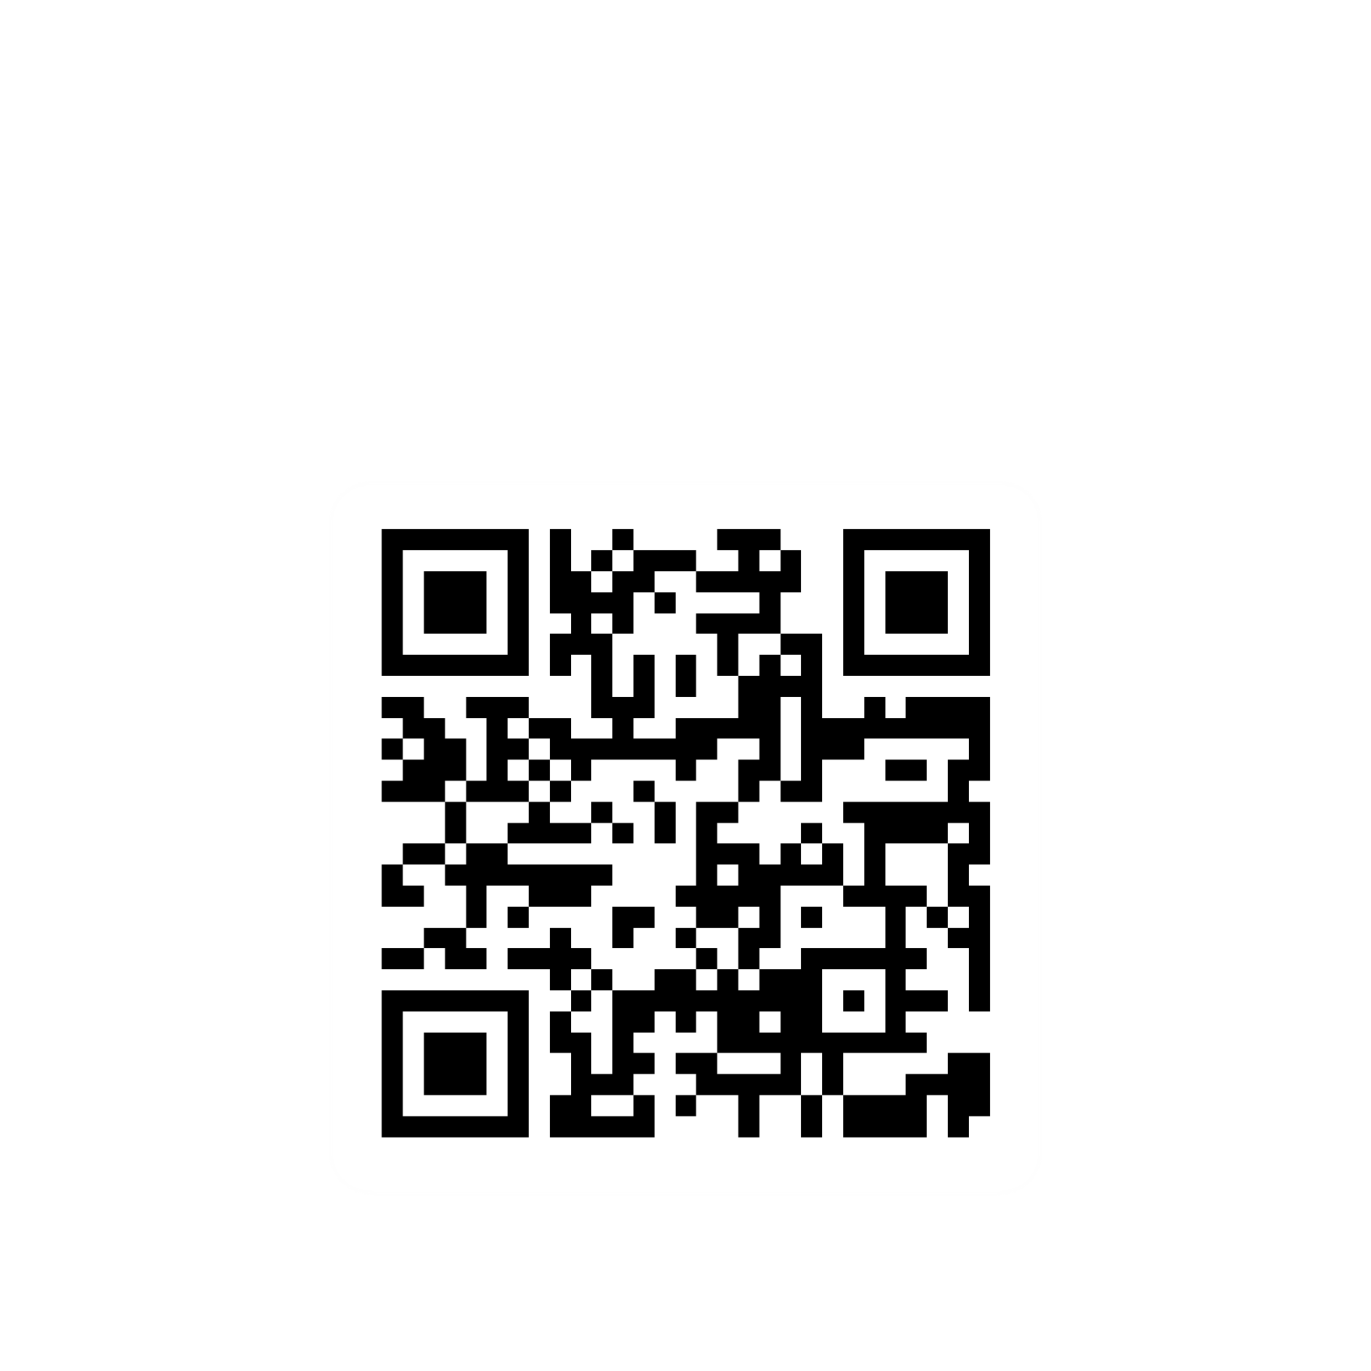
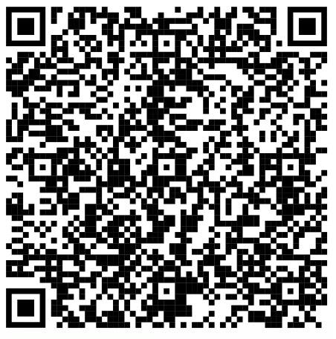
Attendance
Competition Mentor

